Slide 1
Console
Control signals
Video output
CPU
Control Bus
GPU
Screen
BIOS
Cartridge
Video ROM
(images)
Cartridge controller
Video ROM
(images)

Slide 2
GPU
Command request
Drawing functions
Video output
CPU
GPU control
Drawing buffer
Screen
Read pixels
Video ROMs

Slide 3
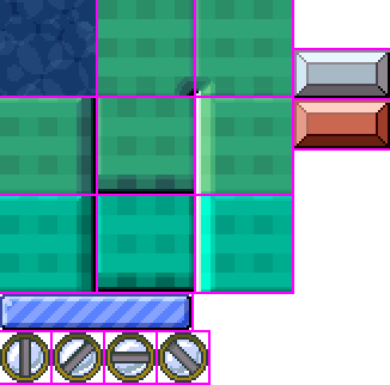
(0, 0)
Texture used by the GPU
Image stored in the cartridge
(1023, 1023)

Slide 4
-1
0
1
2
3
...
selected texture

Slide 5
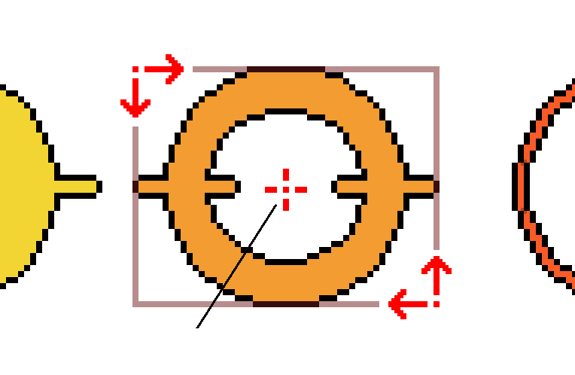
1) Top-Left corner
3) Reference point
2) Bottom-right corner

Slide 6
(0, 0)
Constant
color
Red = 197
Green = 224
Blue = 180
Alpha = 255
(639, 359)

Slide 7

Scale in X = 0.7, in Y = 3

Slide 8
Rotation = -30º

Slide 9
Remove red component

Slide 10


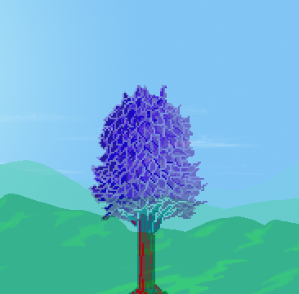

Alpha mode
Add mode
Subtract mode

